Slide 1
Fig 2a: Sptlc1

Slide 2
Figure 2b: 3KDSR

Slide 3
Figure 2c: AC

Slide 4
Figure 2d: GlcCer

Slide 5
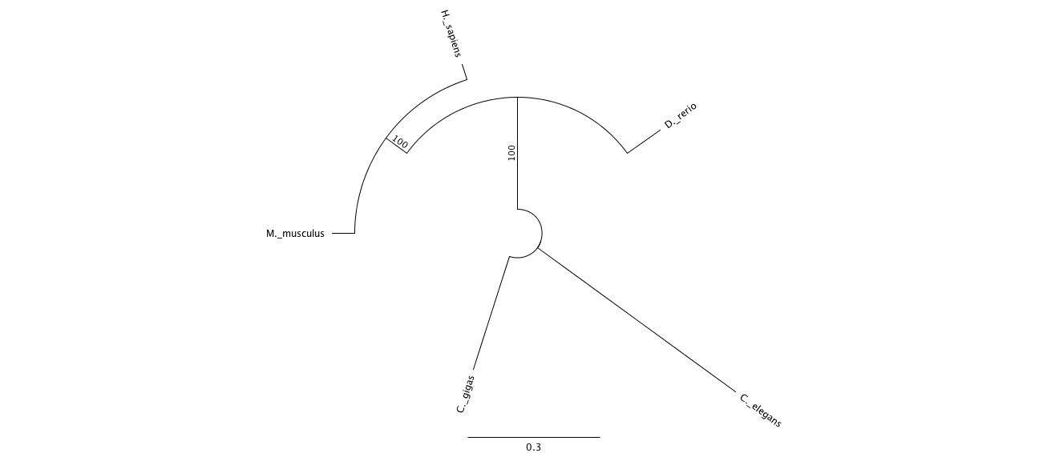
Figure 3a: Sptlc1

Slide 6

Figure 3b: 3KDSR

Slide 7
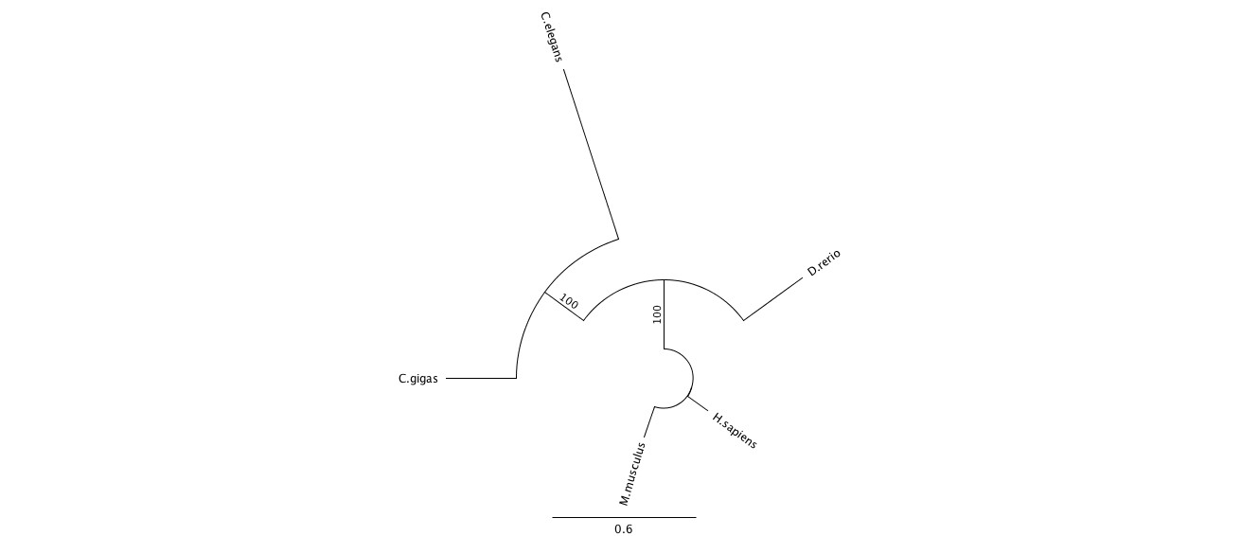
Figure 3c: AC

Slide 8
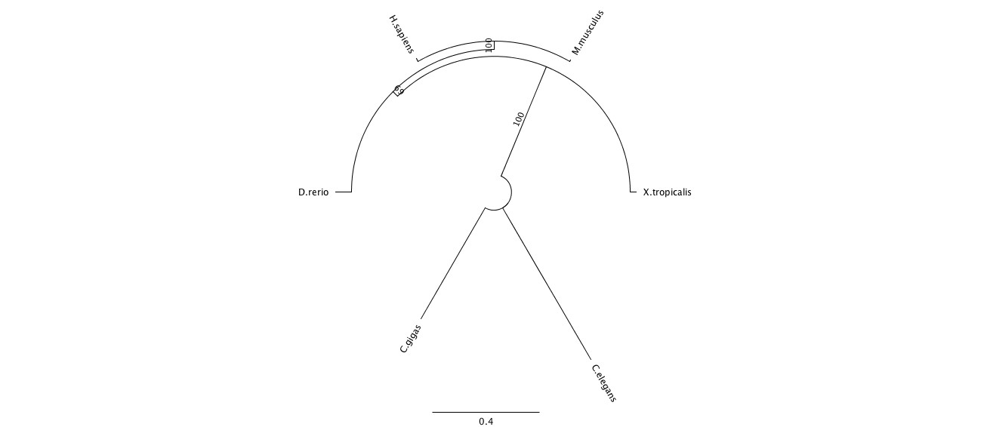
Figure 3d: GlcCer

Slide 9
Figure 4a

Slide 10
NEED TO UPDATE
Figure 4b

Slide 11
Figure 4c

Slide 12
Figure 4d

Slide 13
Sptlc1
3KDSR
GlcCer
Figure 5
Gray = control
White = V. vulnificus exposed
AC
AC
Sptlc1
AC
Sptlc1
GlcCer
3KDSR
3KDSR
GlcCer

